Slide 1
CS6030 – NATURAL LANGUAGE PROCESSING
Language Translation using RNN and LSTM
Team members
- Pravin K (2018103050)
- Ajay S (2018103508)
- Bharathmukil R (2018103520)

Slide 2
INTRODUCTION
Sub-field of computational linguistics that translates text or speech from one natural language to another.
We are translating Tamil to English with the help of NN models.
It leads to a significant impact by helping in the understanding of tamil scripts.
So, it can help to overcome the digital divide.

Slide 3
OVERALL OBJECTIVES
Our method Neural Networks for translating tamil sentence to English.
Our main methodology is focused on calculating frequency of words in corpus.
We preprocessed sentences by tokenizing and padding techniques.
Training models are simple RNN model and LSTM model.
DATASET : taken from Tamil-English parallel corpora.

Slide 4
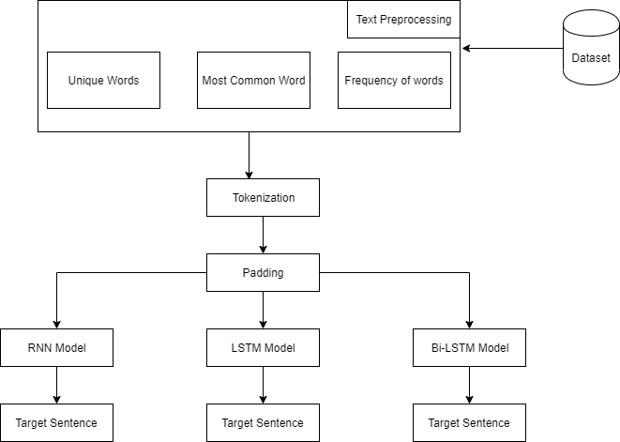
BLOCK DIAGRAM

Slide 5
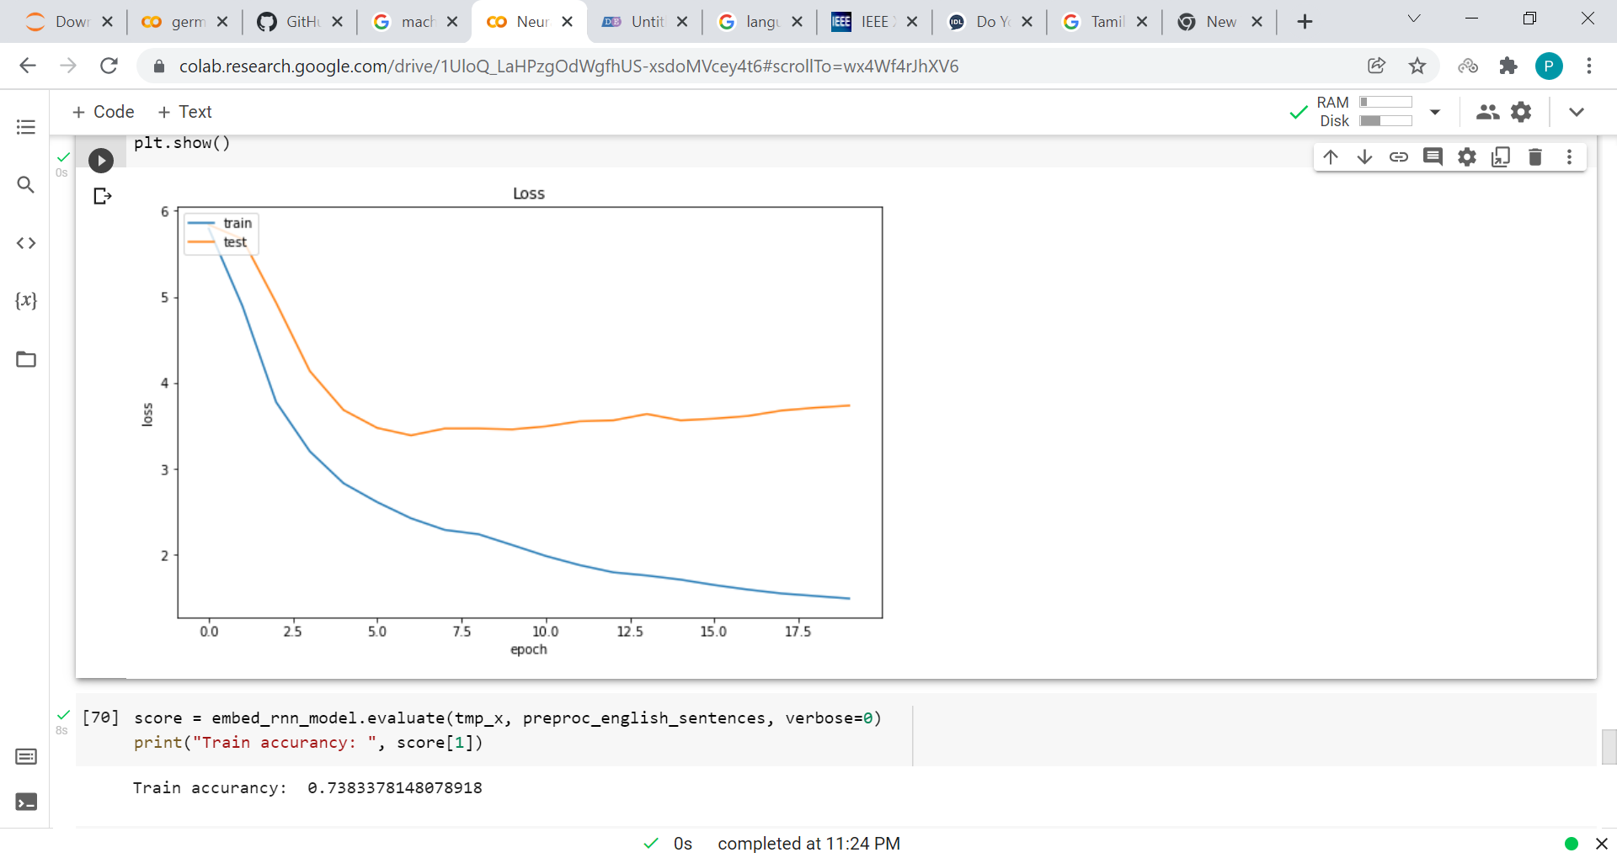
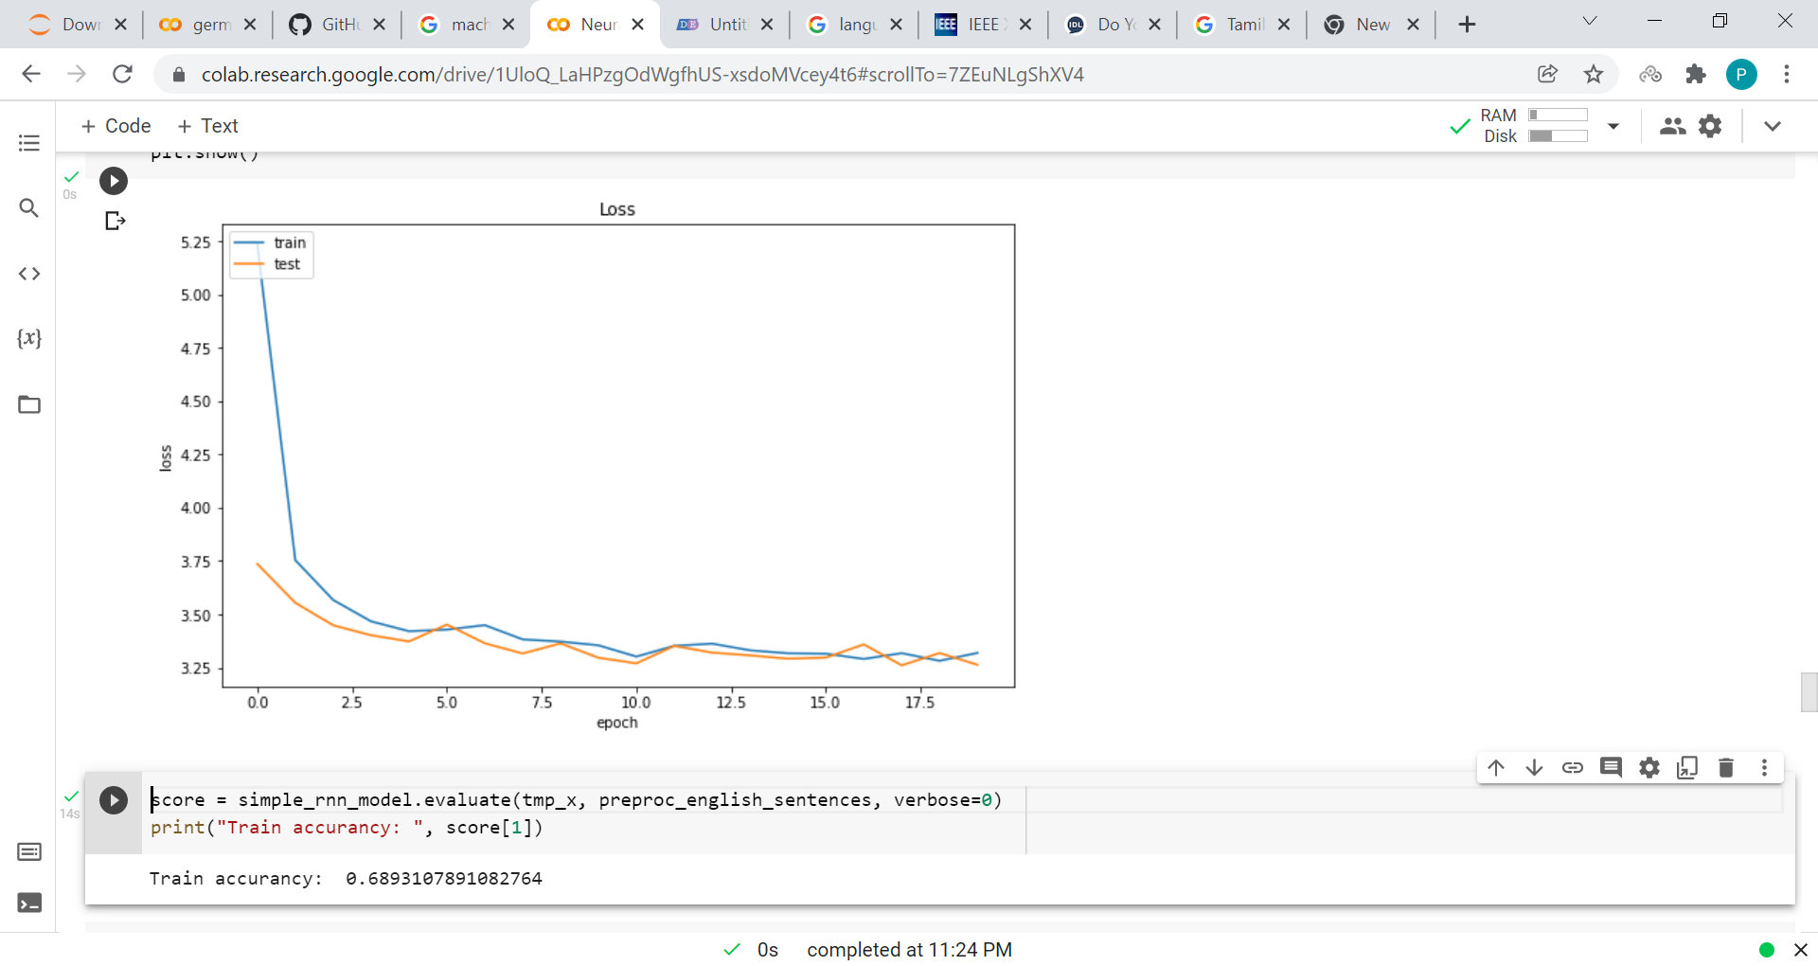
PERFORMANCES
LSTM RNN

